Slide 1
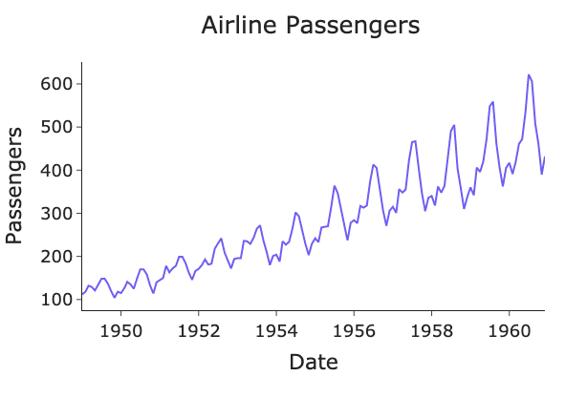
Seasonality in Time Series
Seasonality means a repeating pattern in data that happens at regular time intervals because of time-related factors.
Seasonality = the same behavior repeating again and again over time.
These patterns repeat each year / month / week.

Slide 2
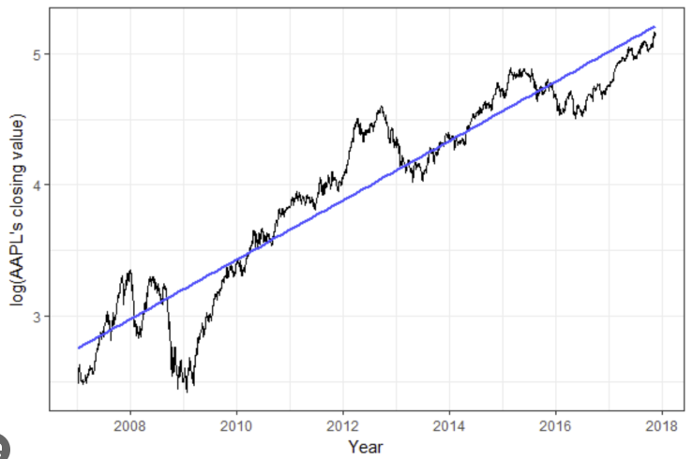
Trend in Time series
Trend is the long-term direction of movement in a time-series data over time.
It shows whether the data is generally increasing, decreasing, or staying stable, ignoring short-term fluctuations

Slide 3
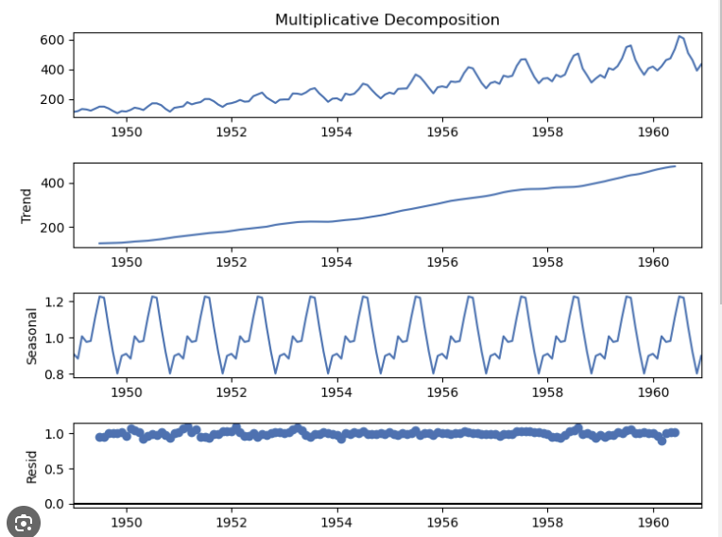
Decomposition of Time series

Slide 4
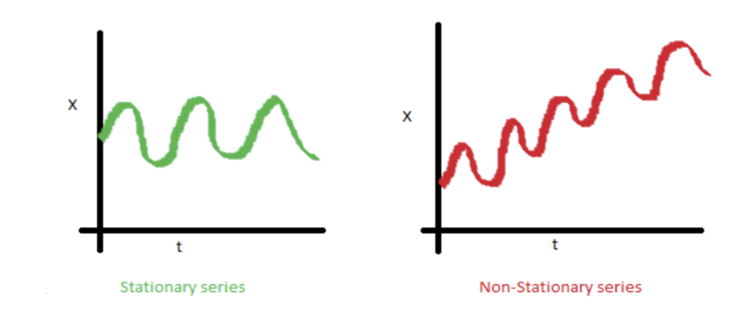
Stationarity in Time series
A Stationary series is one whose statistical properties such as mean, variance, covariance, and standard deviation do not vary with time, or these stats properties are not a function of time. In other words, stationarity in Time Series also means series without a Trend or Seasonal components
A time series is stationary if its statistical properties do not change over time.
That means the data behaves the same way today as it did in the past.
Augmented Dickey-Fuller (ADF) test

Slide 5
Stationarity in Time series
A Stationary series is one whose statistical properties such as mean, variance, covariance, and standard deviation do not vary with time, or these stats properties are not a function of time. In other words, stationarity in Time Series also means series without a Trend or Seasonal components
Augmented Dickey-Fuller (ADF) test
H0 : ts is not stationary
H null : ts is stationary
If p value < 0.05 ts is stationary

Slide 6
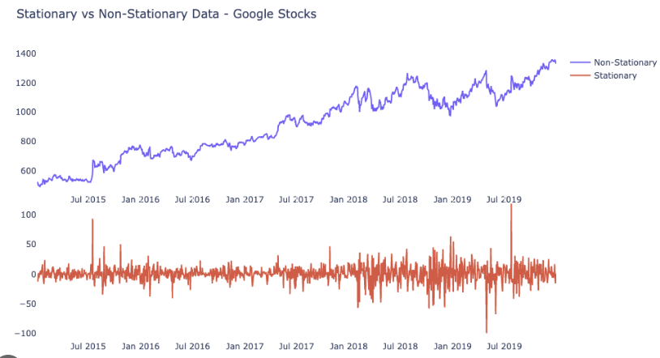
Stationarity in Time series

Slide 7
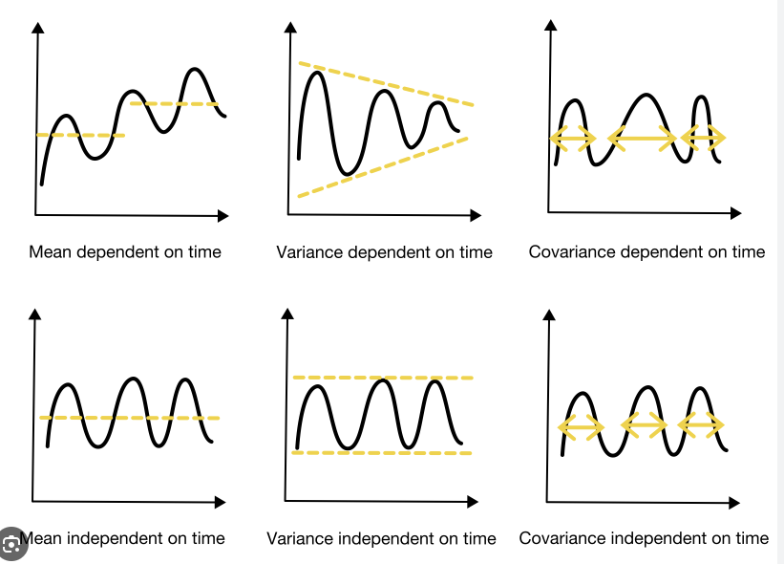
Stationarity in Time series

Slide 8
Transforming
Time series models like ARIMA assume that, data is stationary, because, when it is stationary, the mean, variance and covariance are constant and we can accurately do the statistic analysis
If data is not stationary, data has to be transformed before modelling.
The two most common methods to transform series into stationarity are:
Transformation: Using log or square root to stabilize the non-constant variance.
Differencing: subtracts the current value from the previous one.

Slide 9
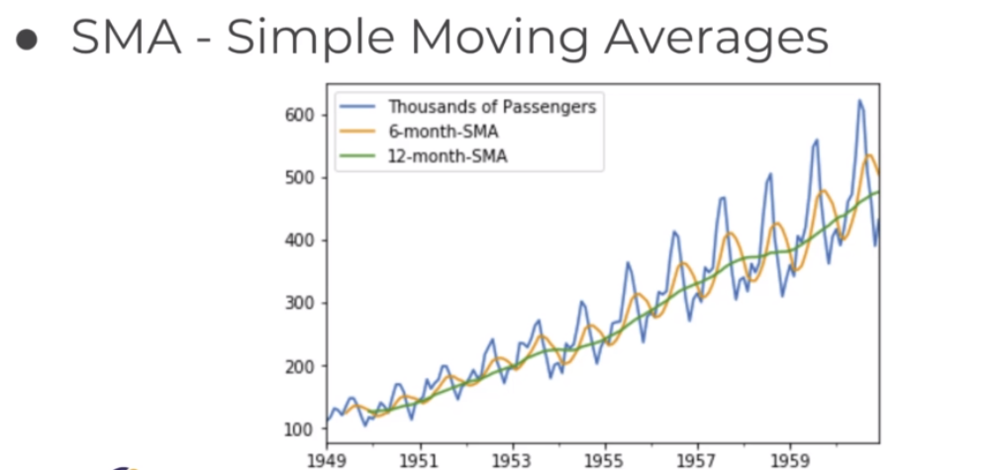

Slide 10
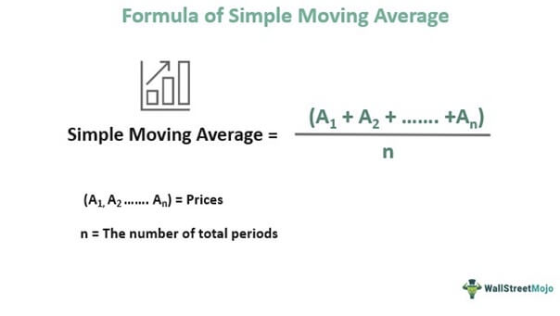
Forecast methods
Simple Moving Average

Slide 11
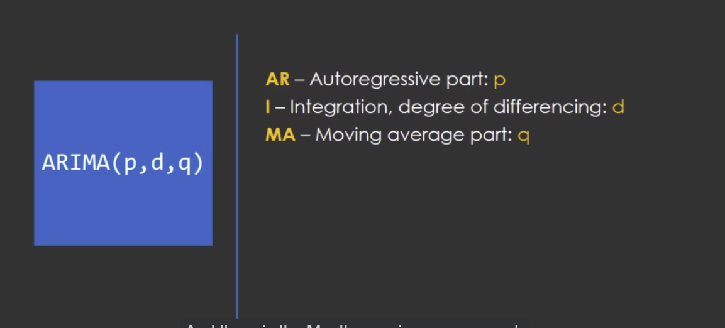
ARIMA – Require stationary TS
Autoregressive Integrated Moving Average

Slide 12
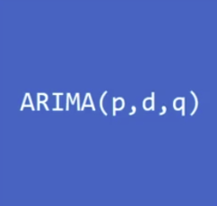
p: the number of lag observations in the model, also known as the lag order.
d: the number of times the raw observations are differenced; also known as the degree of differencing.
q: the size of the moving average window, also known as the order of the moving average.

Slide 13
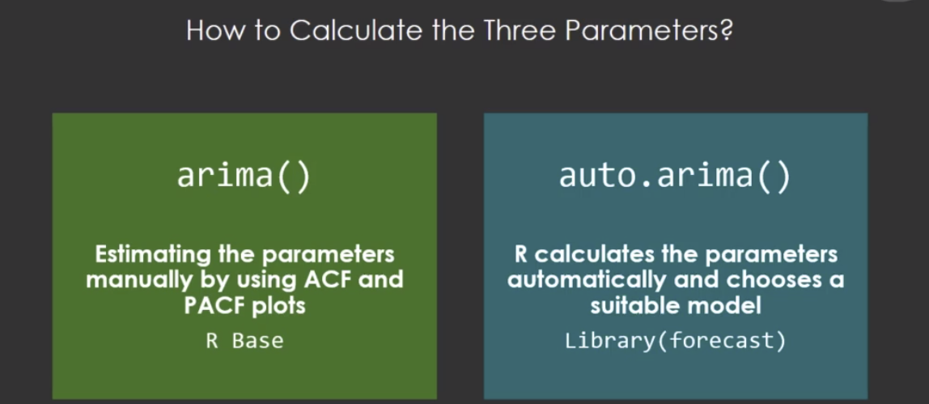

Slide 14
ARIMA (AutoRegressive Integrated Moving Average) is a statistical model used to forecast time-series data by using past values and past errors.
ARIMA works only with stationary time series, which is why differencing (d) is required.
Parameter | Name | Meaning
p | AutoRegressive (AR) | Number of past values used
d | Integrated (I) | Number of differencing operations
q | Moving Average (MA) | Number of past errors used
p- number of past values
p tells the model how many previous time points it should look at to predict the current value.
p = how far back in time the model remembers actual values
p = 1 → look at last month’s sales
p = 2 → look at last month + the month before
p = 3 → look at last 3 months
Small p → short memory
Large p → long memory
Too large p → overfitting risk
The goal is to choose just enough past values to explain the pattern.
p – AutoRegressive (AR)
How many previous observations influence the current value? T
This means today’s value depends on yesterday’s value.
d – Integrated (Differencing)
How many times do we difference the data to make it stationary?
q – Moving Average (MA)
How many past forecast errors influence the current value?

Slide 15
1.p – AutoRegressive (AR)
How many previous observations influence the current value? T
This means today’s value depends on yesterday’s value.
2.d – Integrated (Differencing)
How many times do we difference the data to make it stationary?
d = how many times we transform the data to stop it from drifting up or down
ARIMA cannot work properly on trending data.
So we use differencing to:
remove trend
stabilize the mean
make the series stationary
Original data (trending):100, 110, 120, 130
d = 1 (first difference) : 10, 10, 10 #Now the series is stable.
d = 1 is most common
d > 2 is usually avoided
Use ADF test
p-value < 0.05 → no more differencing needed
p- number of past values
p tells the model how many previous time points it should look at to predict the current value.
p = how far back in time the model remembers actual values
p = 1 → look at last month’s sales
p = 2 → look at last month + the month before
p = 3 → look at last 3 months
Small p → short memory
Large p → long memory
Too large p → overfitting risk
The goal is to choose just enough past values to explain the pattern.
3.q – Moving Average (MA)
How many past forecast errors influence the current value?
q tells the model how many past forecast errors it should remember when predicting the current value.
q = how many past mistakes the model learns from
Even after using past values (p) and differencing (d), predictions are never perfect.
The errors made in the past still contain information.
q | Meaning
q = 0 | Ignore past errors
q = 1 | Use last error
q = 2 | Use last two errors

